Slide 1
TAIEX AGP 64 485
Latest reformed CFP incl. fishing licensing
Headlines

Slide 2
Common Fisheries Policy
Regulation No 1380/2013 of the European Parliament and of the Council of 11 December 2013
Amended by:
Council Regulation (EU) No 1385/2013 of 17 December 2013
Regulation (EU) 812/2015 of the European Parliament and of the Council of 20 May 2015

Slide 3
Common Fisheries Policy
The CFP shall cover:
The conservation of marine biological resources and the management of fisheries and fleets exploiting such resources;
In relation to measures on markets and financial measures in support of the implementation of the CFP: fresh water biological resources, aquaculture, and the processing and marketing of fisheries and aquaculture products.

Slide 4
Common Fisheries Policy
The CFP shall ensure that fishing and aquaculture activities are environmentally sustainable in the long-term.
The CFP shall apply the precautionary approach to fisheries management, and shall aim to ensure that exploitation of living marine biological resources restores and maintains populations of harvested species above levels which can produce the maximum sustainable yield.

Slide 5
Common Fisheries Policy
The CFP shall implement the ecosystem-based approach to fisheries management so as to ensure that negative impacts of fishing activities on the marine ecosystem are minimised
The CFP shall contribute to the collection of scientific data

Slide 6
Common Fisheries Policy
The CFP shall, in particular:
Gradually eliminate discards
Make the best use of unwanted catches, without creating a market for such of those catches
Provide conditions for economically viable and competitive fishing capture and processing industry and land-based fishing related activity
Provide for measures to adjust the fishing capacity of the fleets to levels of fishing opportunities

Slide 7
Common Fisheries Policy
Promote the development of sustainable Union aquaculture activities
Contribute to a fair standard of living for those who depend on fishing activities, bearing in mind coastal fisheries and socio-economic aspects
Contribute to an efficient and transparent internal market for fisheries and aquaculture products and contribute to ensuring a level–playing field for fisheries and aquaculture products marketed in the Union
Promote coastal fishing activities

Slide 8
Conservation measures
Measures for the conservation and sustainable exploitation of marine biological resources may include:
multiannual plans
targets for the conservation and sustainable exploitation of stocks
measures to adapt the fishing capacity of fishing vessels to available fishing opportunities
incentives, including those of an economic nature, such as fishing opportunities, to promote fishing methods that contribute to more selective fishing, to the avoidance and reduction, as far as possible, of unwanted catches, and to fishing with low impact on the marine ecosystem and fishery resources

Slide 9
Conservation measures
minimum conservation reference sizes
pilot projects on alternative types of fishing management techniques and on gears that increase selectivity
limitations or prohibitions on the use of certain fishing gears, and on fishing activities, in certain areas or periods
requirements for fishing vessels to cease operating in a defined area for a defined minimum period in order to protect temporary aggregations of endangered species, spawning fish, fish below minimum conservation reference size, and other vulnerable marine resources

Slide 10
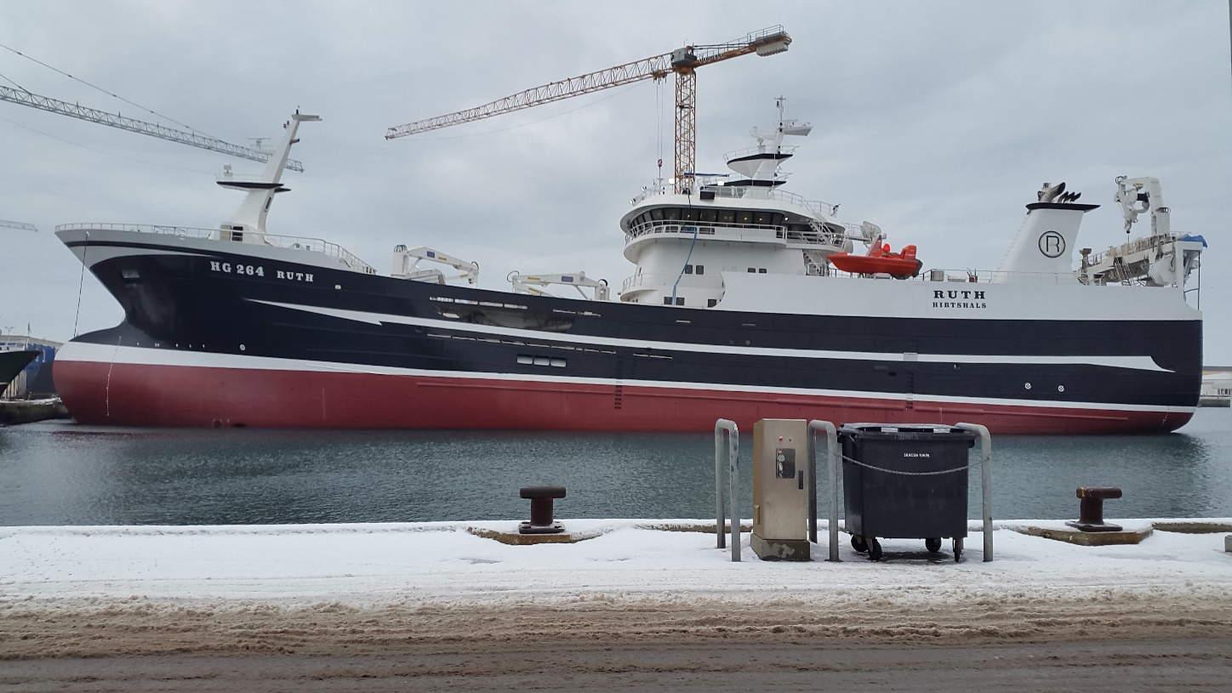
Time for questions!

